Slide 1
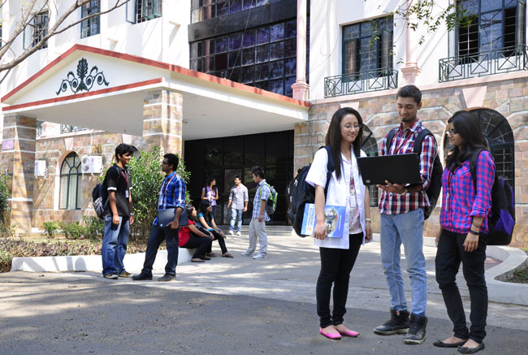

CSB4202 - DATABASE MANAGEMENT SYSTEMS
B.Tech – III Semester
Dr. A. Antonidoss
Associate professor
School of Computing Sciences,
Department of Computer Science and Engineering

Slide 2
MODULE 2: RELATIONAL MODEL
SQL – Data definition- Queries in SQL- Updates- Views – Integrity and Security – Relational Database design – Functional dependencies and Normalization for Relational Databases (up to BCNF).

Slide 3
Views - Database Objects
A View is subset of part of a database. It is a personalized model of a database.
A view can hide data that a user does not need to see. Simplifies the usage of the system and enhance security.
A user who is not allowed to directly access a relation may be allowed to access a part of a relation through view.
Views may also be called as a virtual table.
Provide a mechanism to hide certain data from the view of certain users.

Slide 4
Views - Database Objects
To create a view we use the command:
create view <v> as <query expression> where <query expression> is any legal expression
The view name is represented by v
create view <viewname> as select <fields> from <table name>;
Update of a View
Create a view of all loan data in loan relation, hiding the amount attribute
create view branch-loan as select branch-name, loan-number from loan
Add a new tuple to branch-loan
insert into branch-loan values (‗Perryridge‘, ‗L-307‘)
This insertion must be represented by the insertion of the tuple
(‗L-307‘, ‗Perryridge‘, null) into the loan relation
Updates on more complex views are difficult or impossible to translate, and hence are disallowed.
Most SQL implementations allow updates only on simple views (without aggregates) defined on a single relation

Slide 5
Views - Database Objects - Advantages of Views:
Provide automatic security for hidden data.
Different views of same data for different users.
Provide logical data independence.
Provides the principle of interchangeability and principle of database relativity

Slide 6
Sequence - Database Objects
A sequence is a database object created by a user and can be shared by multiple users.
Use:
To create a primary key value, this must be unique for each row.
Automatically generates unique numbers
Speeds up the efficiency of accessing sequence values when cached in memory.

Slide 7
Sequence - Database Objects
Syntax
To Create Sequence
CREATE SEQUENCE sequence_name [INCREMENT BY n]
[START WITH n] [{MAXVALUE n | NOMAXVALUE}] [{MINVALUE n | NOMINVALUE}]
[CYCLE | NOCYCLE}] [{CACHE n | NOCACHE}];
To use a Sequence
insert into table_name values (sequence_name.nextval,value1,value2, value3,…);

Slide 8
Sequence - Database Objects
Modifying a Sequence
If a MAXVALUE limit is reached in the sequence, no additional values from the sequence will be allocated and an error will be received indicating that the sequence exceeds the MAXVALUE. To continue to use the sequence, it can be modified using the ALTER SEQUENCE statement.
ALTER SEQUENCE sequence_name
[INCREMENT BY n] [{MAXVALUE n | NOMAXVALUE}] [{MINVALUE n | NOMINVALUE}]
[{CYCLE | NOCYCLE}] [{CACHE n | NOCACHE}];

Slide 9
Sequence - Database Objects
Removing a Sequence
To remove a sequence from the data dictionary, use the
DROP SEQUENCE statement.
Once removed, the sequence can no longer be referenced.
DROP SEQUENCE sequence_name;

Slide 10
Synonyms - Database Objects
Direct references to objects. They are used to provide public access to an object, mask the real name or owner of an object, etc. A user may create a private synonym that is available to only that user.
Use the CREATE SYNONYM statement to create a synonym, which is an alternative name for a table, view, sequence, procedure, stored function, package, materialized view, Java class schema object, user-defined object type, or another synonym.
Synonyms provide both data independence and location transparency. Synonyms permit applications to function without modification regardless of which user owns the table or view and regardless of which database holds the table or view. However, synonyms are not a substitute for privileges on database objects. Appropriate privileges must be granted to a user before the user can use the synonym.

Slide 11
Embedded SQL-Static Vs Dynamic SQL
Embedded SQL is a method of combining the power of a programming language and the database. Embedded SQL statements are processed by a special SQL precompiler. The embedded SQL statements are parsed by an embedded SQL.
The output from the preprocessor is then compiled by the host compiler. This allows programmers to embed SQL statements in programs written in any number of languages such as: C Programming language family, COBOL, FORTRAN and Java.
The SQL standard defines embeddings of SQL in a variety of programming languages such as C, Java, and Cobol.
A language to which SQL queries are embedded is referred to as a host language, and the SQL structures permitted in the host language comprise embedded SQL.
The basic form of these languages follows that of the System R embedding of SQL into PL/I.

Slide 12
Embedded SQL-Static Vs Dynamic SQL
EXEC SQL statement is used to identify embedded SQL request to the preprocessor EXEC SQL
<embedded SQL statement > END_EXEC
Note: this varies by language (for example, the Java embedding uses # SQL { …. }; )
From within a host language, find the names and cities of customers with more than the variable amount dollars in some account. Specify the query in SQL and declare a cursor for it
EXEC SQL <query or PL/SQL block> END_EXEC
The statement causes the query to be evaluated EXEC SQL .. END_EXEC The fetch statement causes the values of one tuple in the query result to be placed on host language variables.
EXEC SQL fetch c into :cn, :cc END_EXEC
Repeated calls to fetch get successive tuples in the query result A variable called SQLSTATE in the SQL communication area (SQLCA) gets set to ‗02000‘ to indicate no more data is available The close statement causes the database system to delete the temporary relation that holds the result of the query. EXEC SQL close c END_EXEC

Slide 13
Dynamic SQL
The SQL statements in the program are static; that is, they do not change each time the program is run
Allows programs to construct and submit SQL queries at run time.
The program constructs an SQL statement in a buffer, just as it does for the EXECUTE
IMMEDIATE statement. Instead of host variables, a question mark (?) can be substituted for a constant.
The program passes the SQL statement to the DBMS with a PREPARE statement, which requests that the DBMS parse, validate, and optimize the statement and generate an execution plan for it.
The program can use the EXECUTE statement repeatedly, supplying different parameter values each time the dynamic statement is executed.
Example of the use of dynamic SQL from within a C program.

Slide 14
Dynamic SQL
The SQL statements in the program are static; that is, they do not change each time the program is run
Allows programs to construct and submit SQL queries at run time.
The program constructs an SQL statement in a buffer, just as it does for the EXECUTE
IMMEDIATE statement. Instead of host variables, a question mark (?) can be substituted for a constant.
The program passes the SQL statement to the DBMS with a PREPARE statement, which requests that the DBMS parse, validate, and optimize the statement and generate an execution plan for it.
The program can use the EXECUTE statement repeatedly, supplying different parameter values each time the dynamic statement is executed.
Example of the use of dynamic SQL from within a C program.

Slide 15
Summary
Views - Database Objects
Sequence - Database Objects
Synonyms - Database Objects
Embedded SQL-Static Vs Dynamic SQL
Embedded SQL-Static Vs Dynamic SQL

Slide 16
Quiz
A view can refer to multiple tables via __________ a) UNION b) JOIN c) GROUP d) SELECT

Slide 17
Quiz
Which of these is also known as a virtual table? a) SCHEMA b) DATABASE c) JOIN d) VIEW
Answer b

Slide 18
Quiz
A View can be used to select a subset of the table columns. a) True b) False

Slide 19
Quiz
A View can be used to select a subset of the table columns. a) True b) False
Answer a

Slide 20


Slide 21
The End

